Slide 1

IMDB MOVIE ANALYSIS
NAME- MUSKAN PRITAM

Slide 2


PROJECT OVERVIEW
Project Overview:
- Analyze Trainity's "IMDb Movie Analysis" database.
- Dataset offers information on ratings, genres, cast, production details, and box office performance.
Objective:
- Identify trends, patterns, and insights in the film industry using Excel.
Key Tasks:
- Data Cleaning and Preparation
- Genre Distributions and Rating Trend
- Budget vs. Box Office Performance
- Factors Affecting Movie Ratings
- Visualizing Key Findings
Goal:
- Provide a comprehensive overview of the movie industry.
- Identify trends and factors for film success or failure.
- Showcase Excel’s data handling and interpretation capabilities.

Slide 3
5 WHY’S APPROACH:
Q: "Why do movies with higher budgets tend to have higher ratings?"
A: They can afford better production quality.
Q: "Why does better production quality lead to higher ratings?"
A: It enhances the viewer's experience.
Q: "Why does an enhanced viewer experience lead to higher ratings?"
A: Viewers are more likely to rate a movie highly if they enjoyed watching it.
Q: "Why are viewers more likely to rate a movie highly if they enjoyed watching it?"
A: Positive experiences lead to positive reviews.
Q: "Why do positive reviews matter?"
A: They influence other viewers' decisions to watch the movie, increasing its popularity and success.

Slide 4


DATA ANALYTICS TASKS

Slide 5
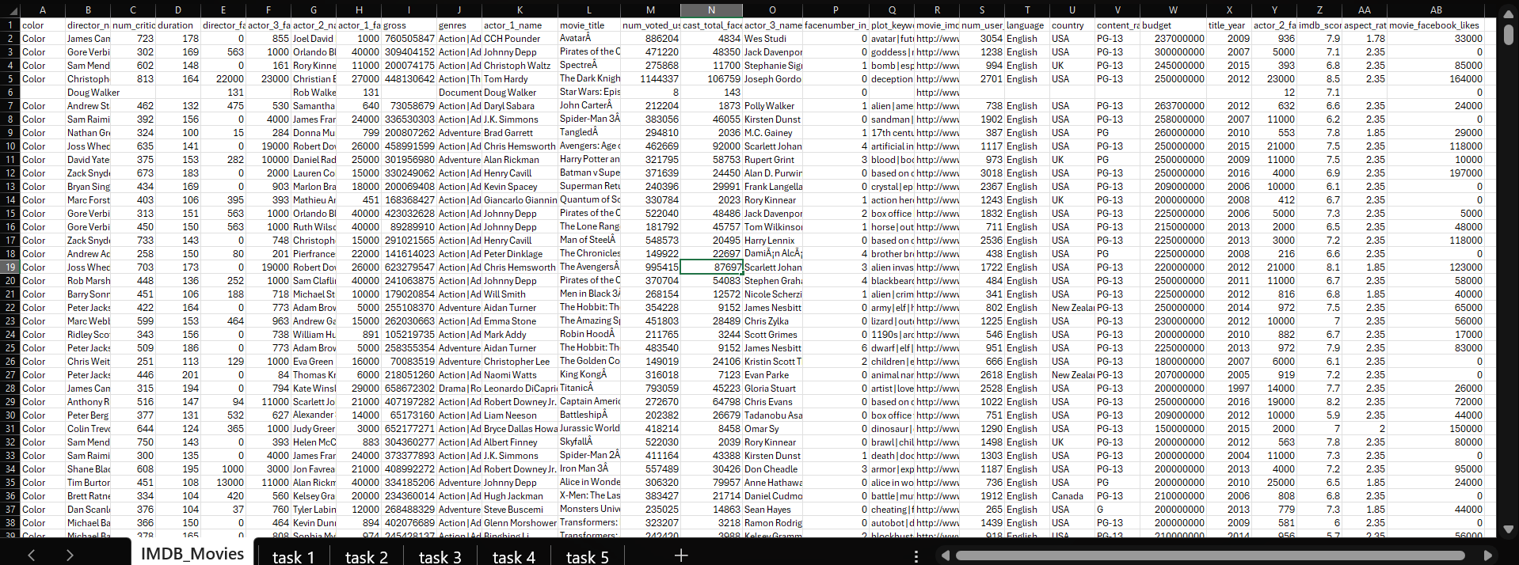
Here we have the data in excel using which we will answer the questions given in tasks.
We are going to do our tasks in different sheets for no confusion in future.
LET’S START WITH OUR FIRST TASK

Slide 6
1:Movie Genre Analysis: Analyze the distribution of movie genres and their impact on the IMDB score. Task: Determine the most common genres of movies in the dataset. Then, for each genre, calculate descriptive statistics (mean, median, mode, range, variance, standard deviation) of the IMDB scores.
FORMULAS USED:
FOR COUNTING TOTAL NUMBER OF MOVIES ACCORDING TO MOVIE NAME: =COUNTIF($A$2:$H$5044,K2)
MEAN: =IFERROR(AVERAGEIF($A$2:$H$5044,K2,$J$2:$J$5044),0)
MEDIAN: =IFERROR(MEDIAN(IF($A$2:$H$5044=K2,$J$2:$J$5044)),0)
MIN: =IFERROR(MIN(IF($A$2:$H$5044=K2,$J$2:$J$5044)),0)
MAX: =IFERROR(MAX(IF($A$2:$H$5044=K2,$J$2:$J$5044)),0)
VARIANCE: =IFERROR(VAR.S(IF($A$2:$H$5044=K2,$J$2:$J$5044)),0)
STANDARD DEVIATION: =IFERROR(STDEV.S(IF($A$2:$H$5044=K2,$J$2:$J$5044)),0)
MODE: =IFERROR(MODE.SNGL(IF($A$2:$H$5044=K2,$J$2:$J$5044)),0)
Output: In this task, we were asked to initially recognize the movie distribution and then do a descriptive statistical analysis of their imdb scores.
For this task, we used various formulas. The formula with their usage is listed :
TABLE OUTPUT IS IN NEXT SLIDE ALONG WITH FEW ASSUMPTIONS THAT CAN BE MADE BY LOOKING AT DATA AND THE PATTERN.

Slide 7
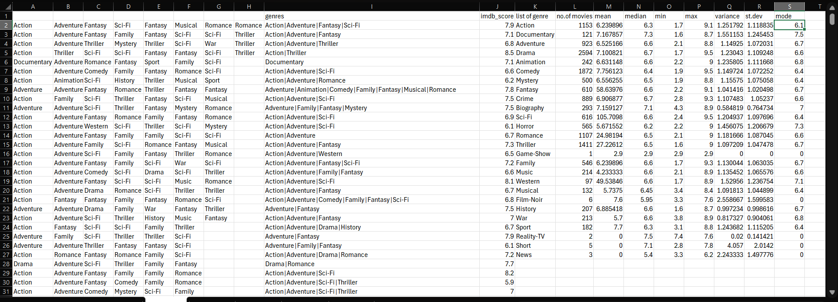
BY LOOKING AT THE DATA WE CAN SAY THAT THERE ARE TOTAL 27 TYPES OF UNIQUE GENRE AND THUS USING THE LIST OF GENRE , GENRE AND IMDB SCORE COLUMN WE CALCULATED THE NUMBER OF MOVIES, MEAN,MEDIAN,MODE, MIN,MAX,VARIANCE AND STANDARD DEVIATION. WHICH HELPS IN ANALYSING DISTRIBUTION AND IMPACT OF IMDB SCORE ON MOVIES.

Slide 8
2.Movie Duration Analysis: Analyze the distribution of movie durations and its impact on the IMDB score. Task: Analyze the distribution of movie durations and identify the relationship between movie duration and IMDB score.
FORMULAS USED:
MEAN: =AVERAGE(A2:A5044)
MEDIAN: =MEDIAN(A2:A5044)
STANDARD DEVIATION: =STDEV.S(A2:A5044)
OUTPUT :In this task, we are required to find out the distribution of the movie duration and we also have to form an idea about how the imdb score reacts to the movie duration. For this task, we initially find out the mean, median and standard deviation of the duration of the movies.
After finding the above values, we plot a scatter plot graph:
imbd scores v/s duration to show the relation between the two.

Slide 9
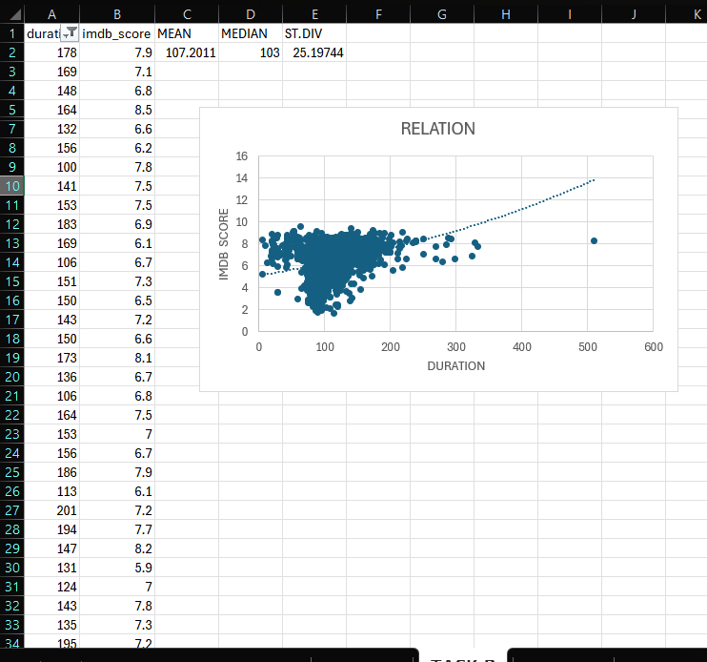
BY LOOKING AT THE OUTPUT WE CAN SEE THAT THE MEAN OF THE DURATION IS 107.2011 ALSO MEDIAN IS 103 AND STANDARD DEVIATION IS 25.19744.
BY PLOTTING A SCATTER CHART WE CAN SEE THAT IMDB SCORE AND DURATION IS HIGHLY RELATED TO EACH OTHER AND IF WE USE A TRENDLINE WE CAN SEE A POSITIVE EXPONENTIAL GROWTH IN THE RELATIONSHIP BETWEEN THESE TWO.

Slide 10
3.Language Analysis: Situation: Examine the distribution of movies based on their language. Task: Determine the most common languages used in movies and analyze their impact on the IMDB score using descriptive statistics.
FORMULAS USED:
COUNT: =COUNTIF($A$2:$A$5044,C2)
MEAN: =AVERAGE(A2:A5044)
MEDIAN: =MEDIAN(A2:A5044)
STANDARD DEVIATION: =STDEV.S(A2:A5044)
OUTPUT: In this task, we are required to find the distribution of movies as per their language , i.e , which language has more number of movies and which has a lesser number. For this task, we first must get the different list of languages in the dataset. I did this by using the: =UNIQUE: Used to find the unique entries in a column or dataset.
TABLE OUTPUT IS IN NEXT SLIDE ALONG WITH FEW ASSUMPTIONS THAT CAN BE MADE BY LOOKING AT DATA AND THE PATTERN.

Slide 11
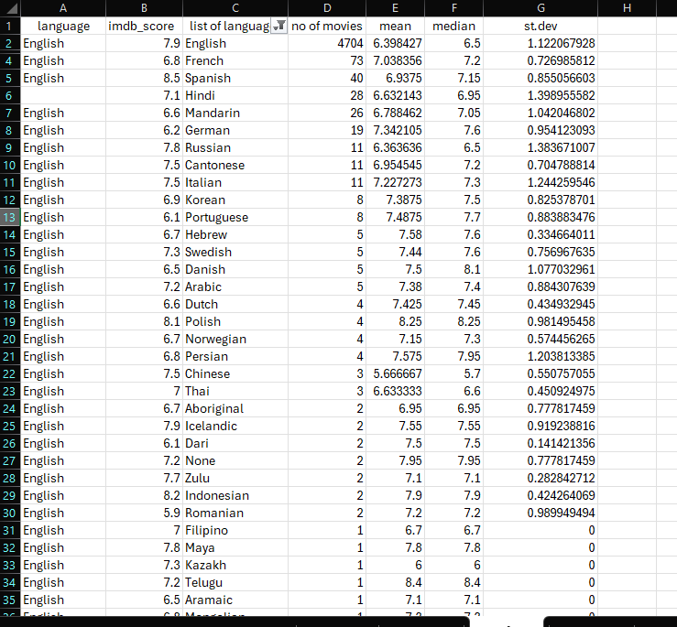
BY looking at the output ,we see that we first used the unique function to find out the list of unique languages in which movies are made.
Now by looking at the list of languages as a reference we can count the number of movies languages . We also found the mean, median and standard deviation for each of the languages using the language column and IMDb column.

Slide 12
4:Director Analysis: Influence of directors on movie ratings. Task: Identify the top directors based on their average IMDB score and analyze their contribution to the success of movies using percentile calculations.
FORMULAS USED:
AVERAGE SCORE: =AVERAGEIF($A$2:$A$5044, A2, $B$2:$B$5044)
PERCENTILE: =PERCENTILE($C$2:$C$5044,0.9)
NUM OF DIRECTORS HAVING MORE THAN 7.48 IMDB: =COUNTIF(C2:C5044,">7.48")
OUTPUT: In this task, we are required to find out the top directors by calculating their average imdb scores. We are also required to find out the contribution of the directors in the film industry and how many directors are doing good in the industry.
We do so by first calculating an average of the imdb scores of a the directors.
Then using the percentile function, we get a imdb score which would be considered good to calculate the contribution.
Then, we can calculate the number of directors who have an average imdb score of the required criteria. That is the number of directors who are preforming good.
TABLE OUTPUT IS IN NEXT SLIDE ALONG WITH FEW ASSUMPTIONS THAT CAN BE MADE BY LOOKING AT DATA AND THE PATTERN.

Slide 13
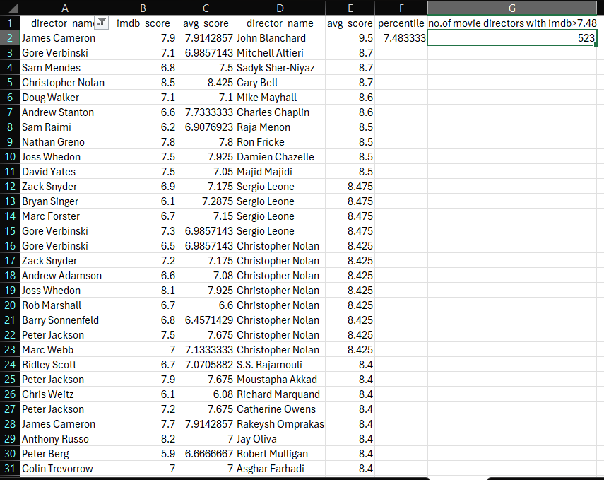
Looking at the table beside we first found out the average score IMDb score column using the director name for each director.
Then in the next column we sorted the average score in descending order.
Then using this average score we calculated the percentile using which we will be able to see how many directors have IMDb more than the percentile that is here 7.48 after calculating this we found out that there are 523 directors that have an IMDb more than 7.48 and are considered to be.

Slide 14
5.Budget Analysis: Explore the relationship between movie budgets and their financial success. Task: Analyze the correlation between movie budgets and gross earnings , and identify the movies with the highest profit margin.
FORMULAS USED:
PROFIT: =C2-B2
MOVIE WITH HIGHEST PROFIT MARGIN: =MAX(D2,D5044)
CO- RELATION: =CORREL(B2:B5044,C2:C5044)
OUTPUT:
In this task, we are required to find out the movies with the highest gross margins and also find out the correlation between movie budget and gross earnings.
To find the correlation, we use the =CORREL function which gives the correlation of a range of values.
To find the profit margin, we subtracted the budget from the gross.
To find the highest profit margin of a movie, we have to use the =MAX function on the profit margin column.
TABLE OUTPUT IS IN NEXT SLIDE ALONG WITH FEW ASSUMPTIONS THAT CAN BE MADE BY LOOKING AT DATA AND THE PATTERN.

Slide 15
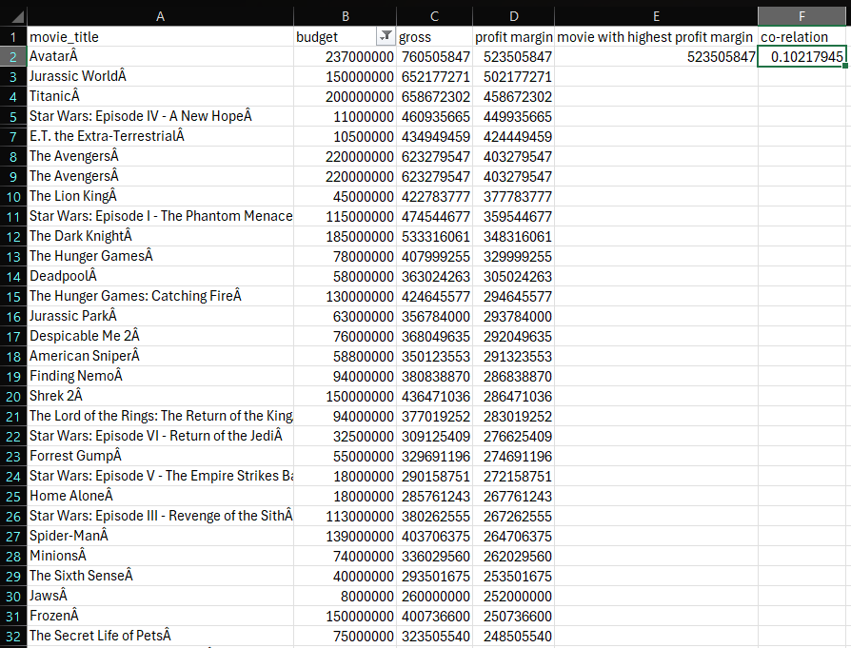
In the table there is budget and gross of movies along with movie title
We need to find out the profit margin which we will get by subtracting the gross and budget and in the profit margin column we got the profit for each of the movie title’s separately.
In the next column we found out the highest movie margin by using the Max function.
Also we found out the correlation between budget and gross which came out to be 0.102 which is quite less hence means that budget and gross are not related strongly.

Slide 16
Thank you

